Slide 1


The Last Group
Microsoft Applications for Travel Experts

Slide 2
Our Team
Kai Feng
Victor Lantion
Shanice Talan

Slide 3
Project Milestones
June 2019
Website prototype
August 2019
Microsoft Applications
October 2019
Mobile Application

Slide 4

Microsoft Applications
For Agents:
Graphical interface to view, add, modify, and delete packages, products and suppliers
For Customers:
A website where customers can register, login, and view their recent and past bookings.

Slide 5
Agent Interface

Slide 6
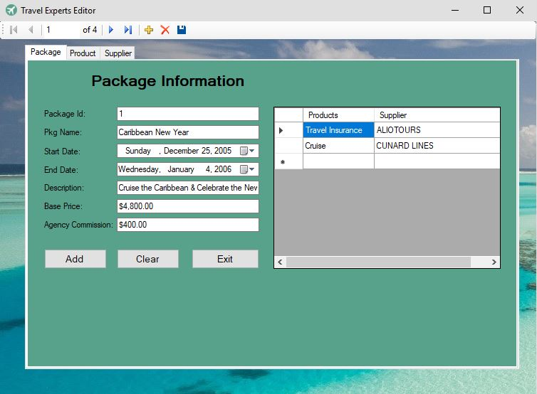
Packages Window

Slide 7
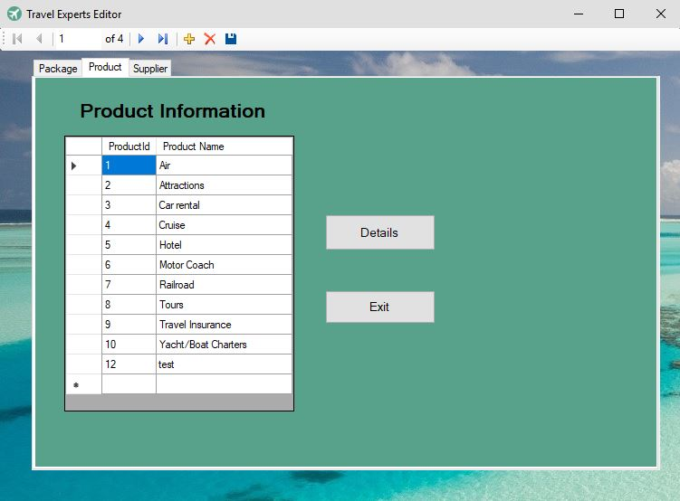
Products Window

Slide 8
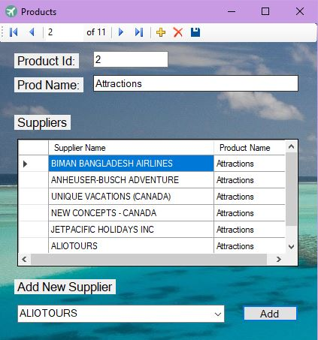
Products Details

Slide 9
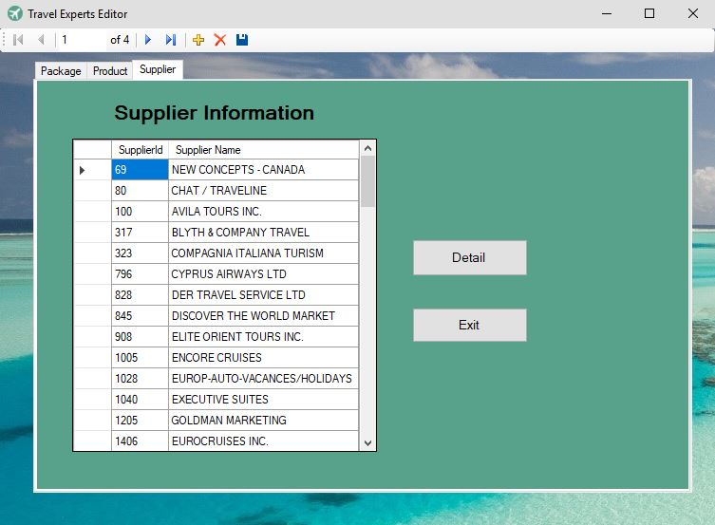
Suppliers Window

Slide 10
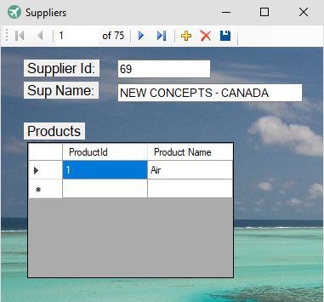
Suppliers Details

Slide 11
Customer Interface

Slide 12
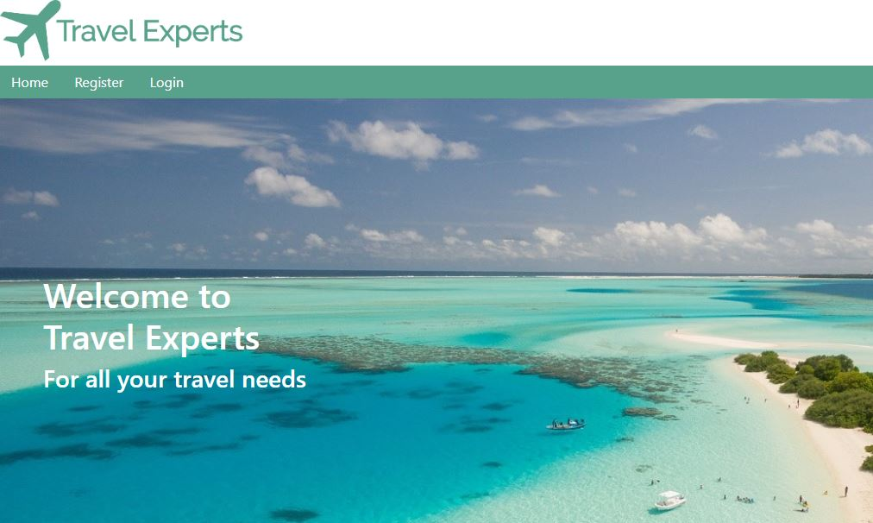
Homepage

Slide 13
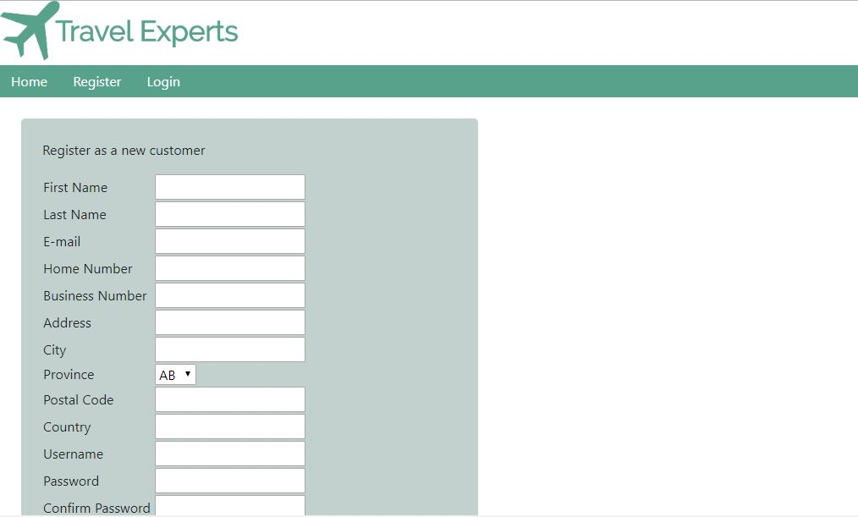
Registration Page

Slide 14
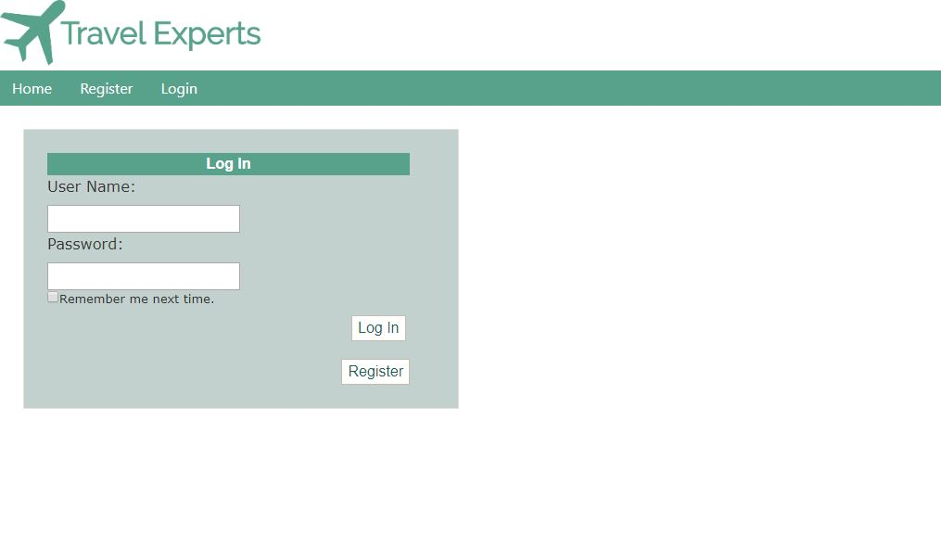
Login Page

Slide 15
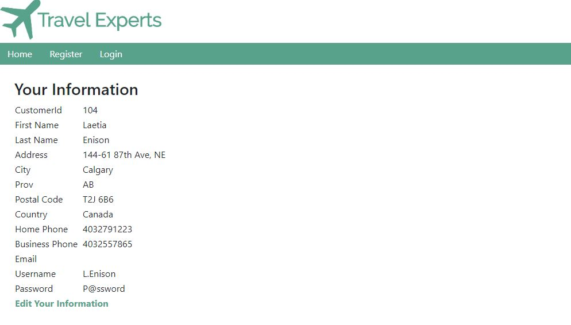
Customer Bookings Page

Slide 16
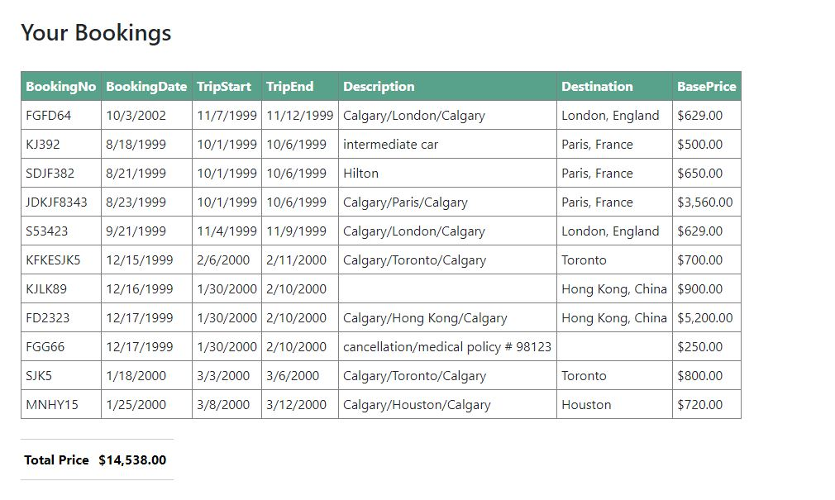
Customer Bookings Page

Slide 17
Demo

Slide 18
Thank you Any Questions?

